Slide 1
Fantasy Football Performance Analysis
Aaron Rofe, Dylan Stafeil, Brett Cerenzio

Slide 2
Simple Overview of Fantasy Football
Fantasy football is a game where users act as “team managers” and draft lineups of real NFL players.
Each week, players receive fantasy points based on real-world stats such as:
Passing yards and touchdowns
rushing/receiving yards and touchdowns
Receptions (PPR Scoring - players earn a point for each catch made)
Defensive and kicking stats
Managers compete by scoring more points than their opponent in their own league each week

Slide 3
Why Analyze Fantasy Football Data?
Fantasy football relies heavily on:
Players projected points
Week-to-week performance variability
injury/bye week impacts
Aging curves and career arcs
A player’s own teammates and opponent
Our project explores whether projections are accurate, which players/positions are most consistent, how performance changes under different conditions

Slide 4
Data
We collected our data from the Sleeper API
Dataset was player-week observations from 2018-2024
Dataset with all players included as ~79,000 rows
Columns include:
Player info: Player ID, name, team, age, position
Weekly stats: passing yards/TDs, rushing yards/TDs, receiving yards/TDs, receptions, defensive and kicking stats
Fantasy scoring: PPR points and projected PPR points
Season and week indicators

Slide 5
Data Cleaning
To prepare the dataset, we:
Removed data on unnecessary scoring formats (standard, half-PPR)
Filtered out players with less than 5 projected points for the week
Merged in player birthdate to calculate their ages for aging curve analysis
Positions kept: QB, RB, WR, TE, K, DEF
Final dataset has ~30,000 rows

Slide 6
Questions
Which positions contribute the most consistent fantasy points per week? Which positions perform most consistently to their projections?
Which players outperform projections most often?
Are there seasonal trends in fantasy scoring (e.g., higher scoring in later weeks)?
How are players affected coming off an absence (injury/bye week)?
How well does previous season fantasy points project next season’s fantasy points? Are there specific stats that project this better than others?
How do projections adjust for performance from the previous week? Are they over-adjusting or under-adjusting?
Aging curve for fantasy projections and outcomes. How does age affect performance and projections?

Slide 7
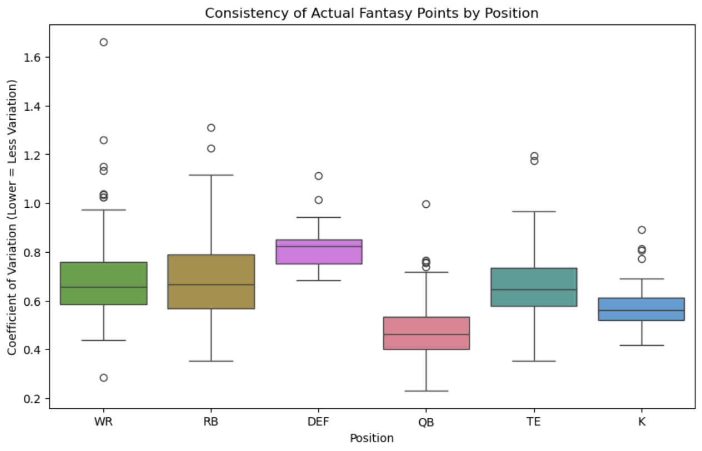
Which positions contribute the most consistent fantasy points per week?
Coefficient of Variation = st. dev / mean for each player.
QB’s are the most consistent performers
Defense performance varies the most, but variation is pretty consistent across all defenses.
WR, RB, and TE have the widest range of variation.

Slide 8
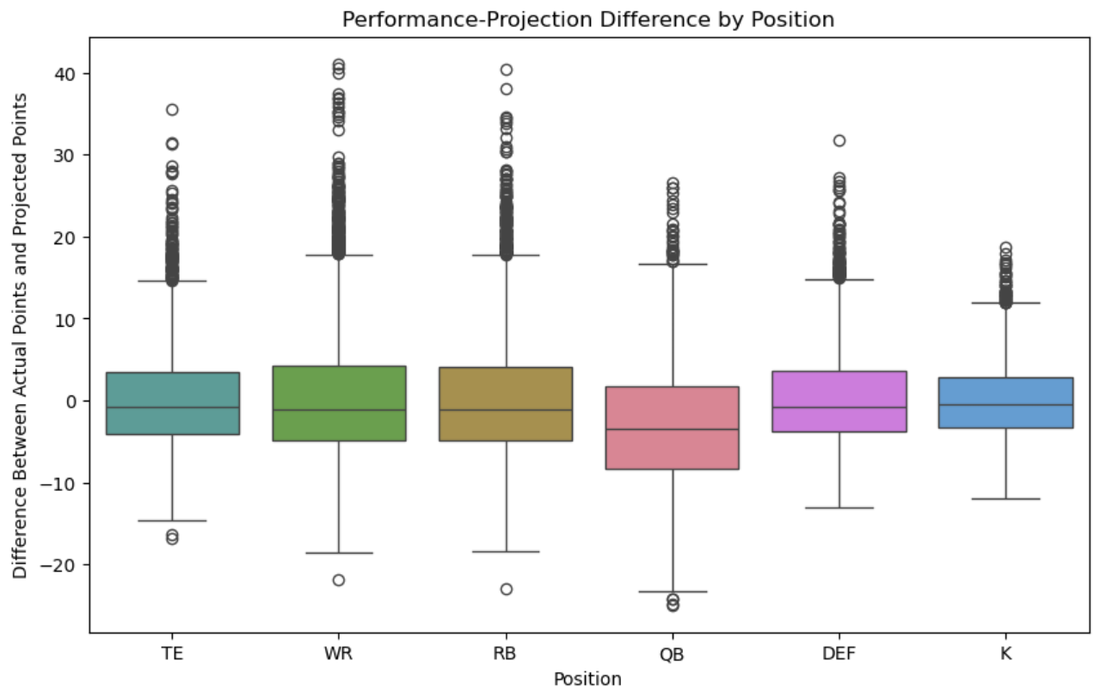
Which positions perform most consistently to projections?
On average, QB’s underperform projections.
All other positions perform pretty consistently to their projections, on average.

Slide 9
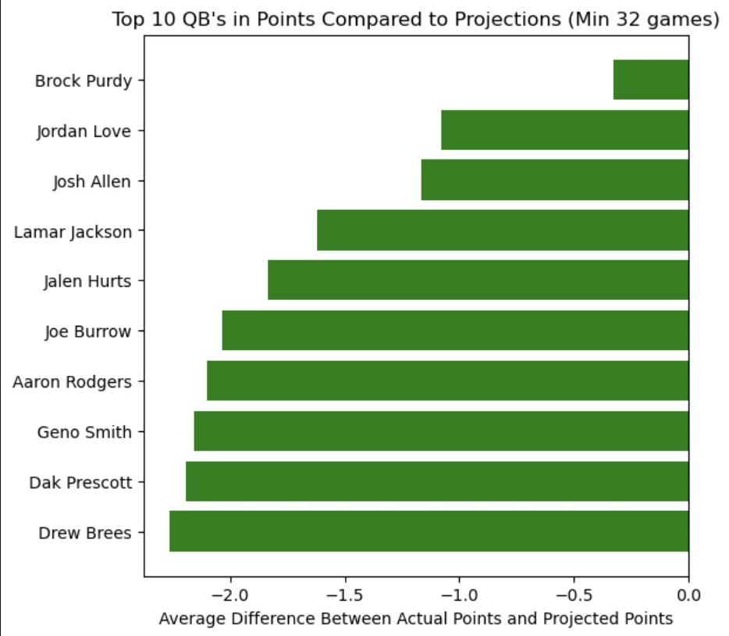
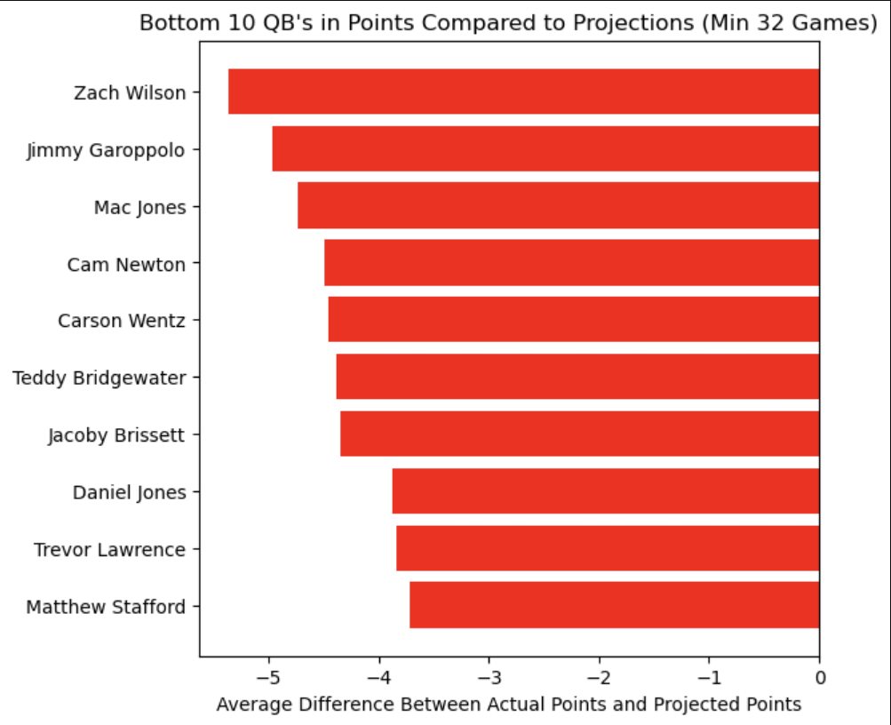
Which players outperform projections most often? QB

Slide 10
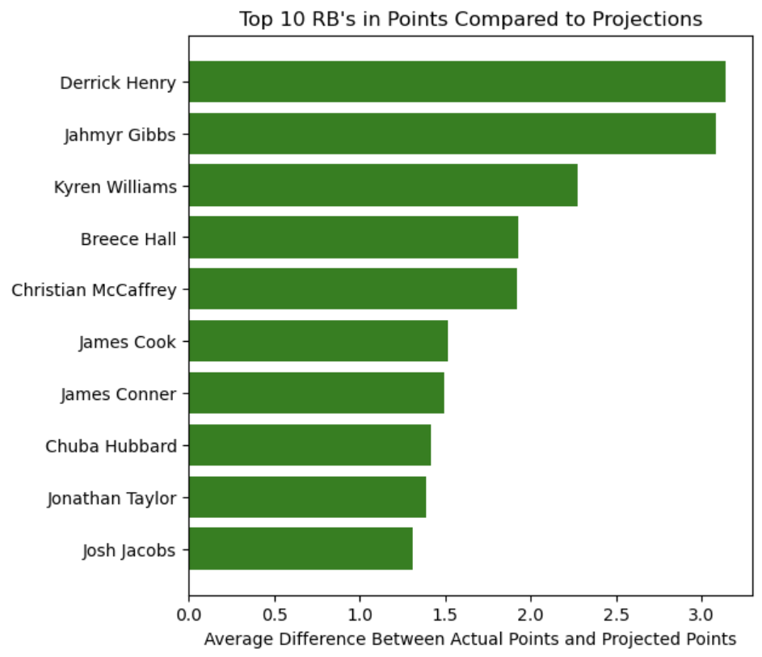
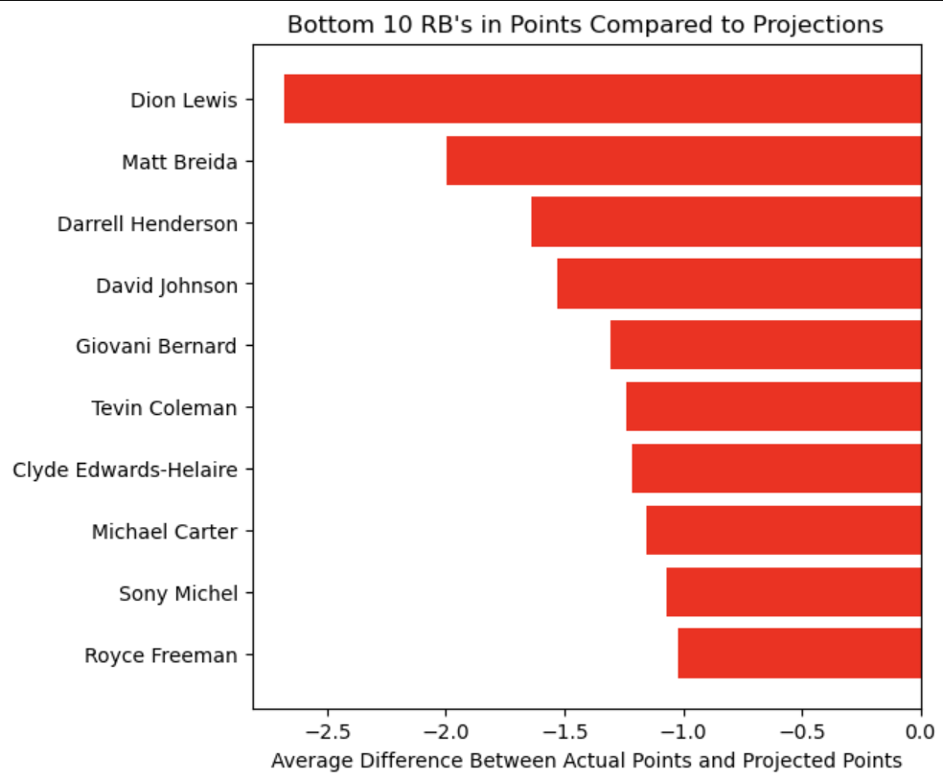
Which players outperform projections most often? RB

Slide 11
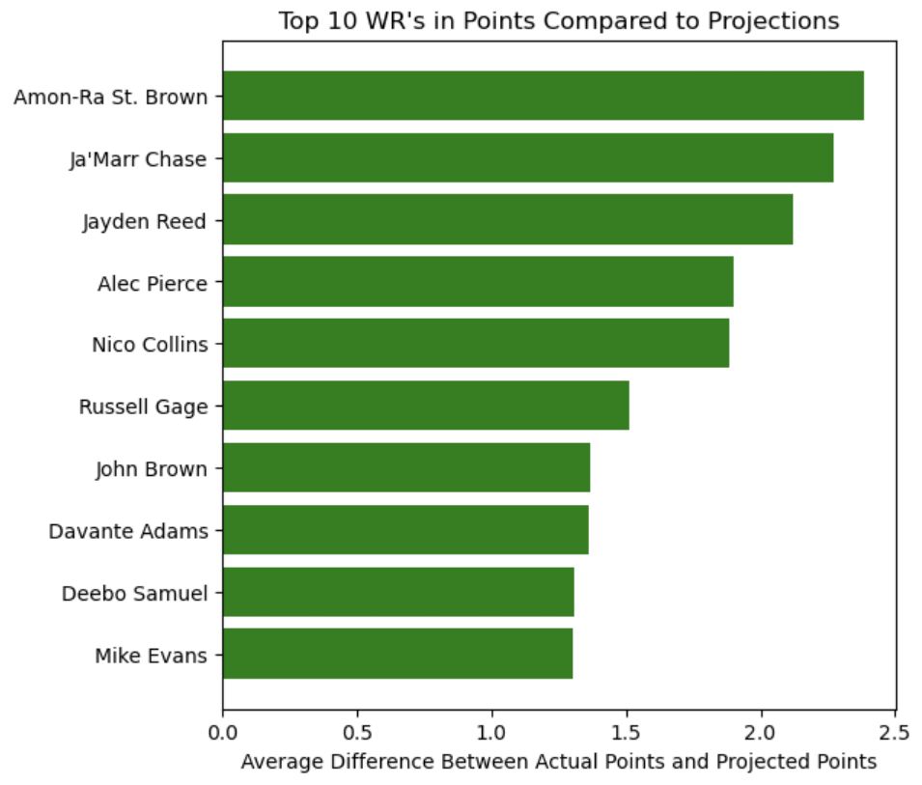
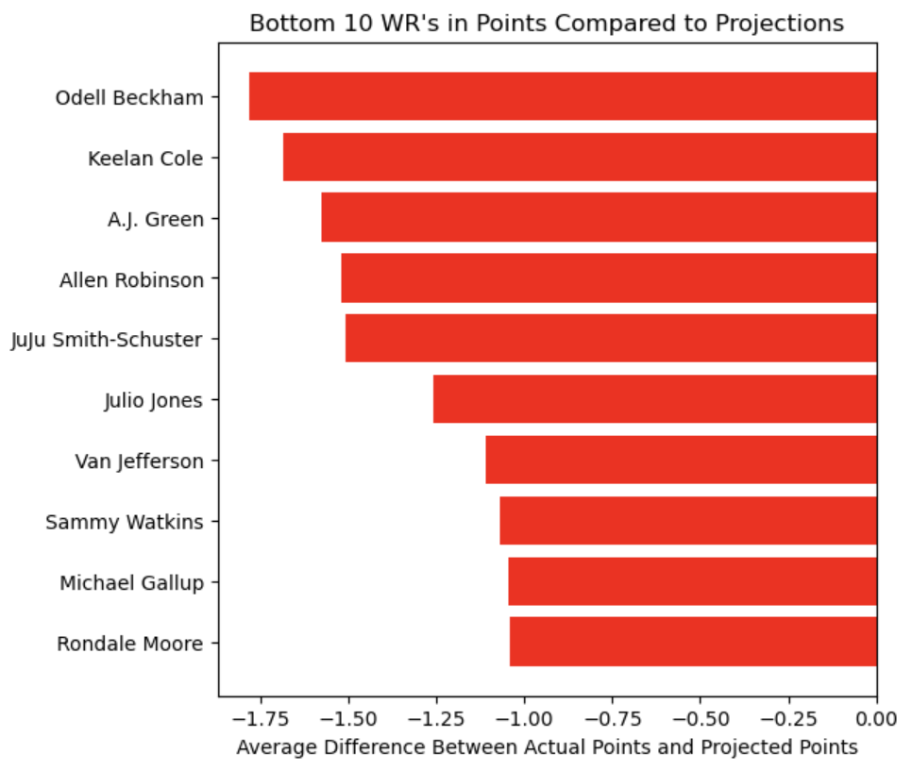
Which players outperform projections most often? WR

Slide 12
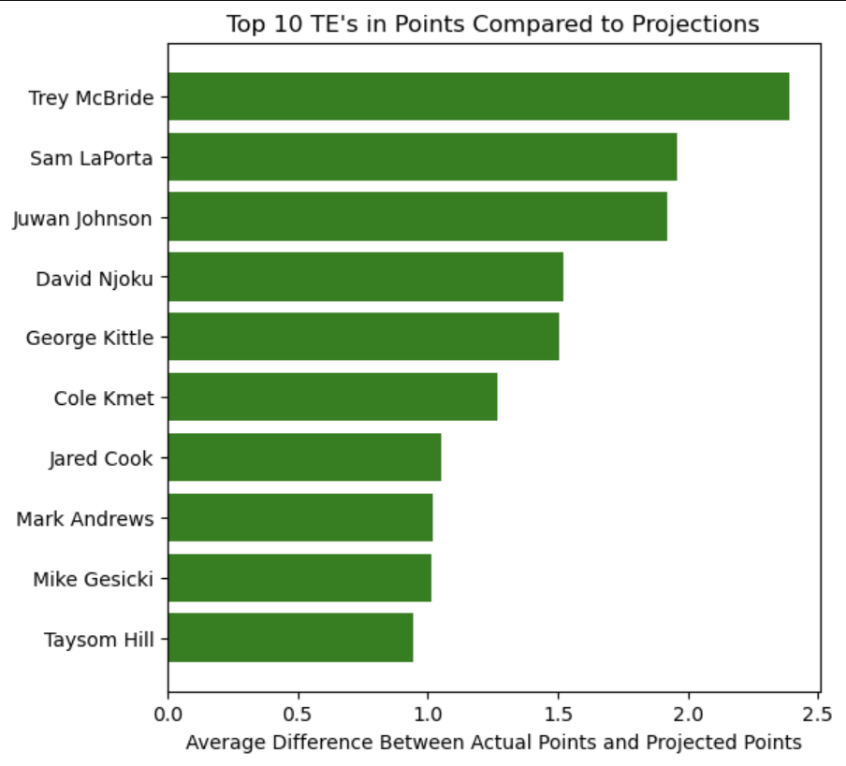
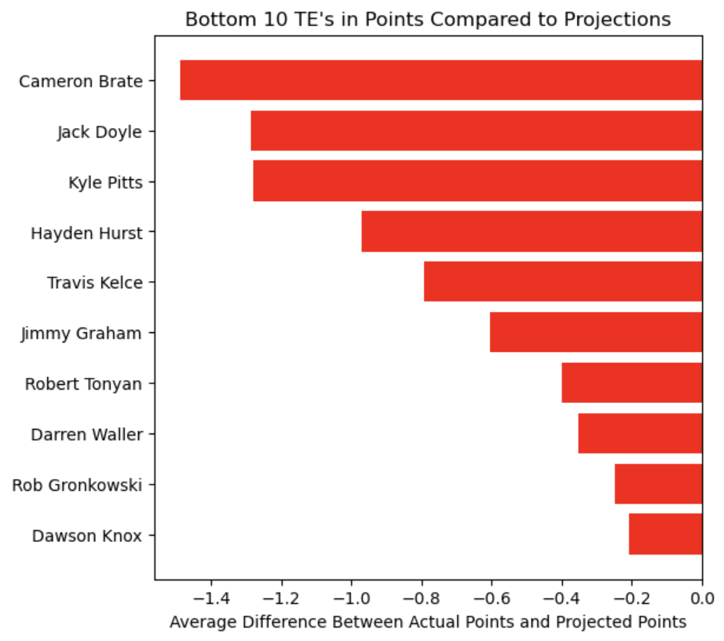
Which players outperform projections most often? TE

Slide 13


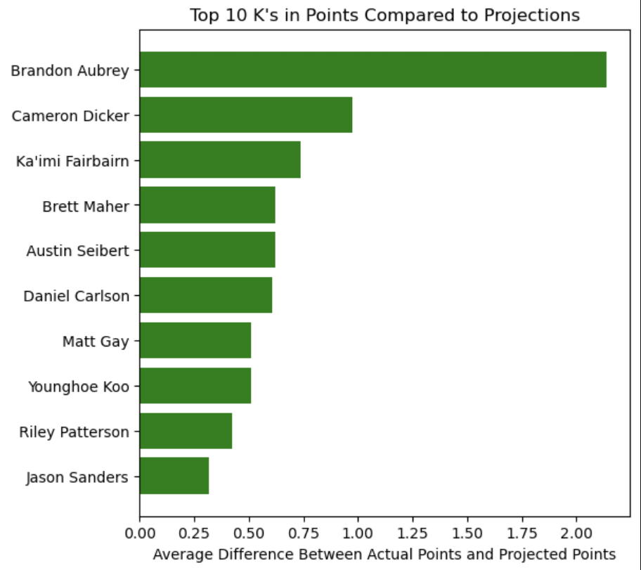
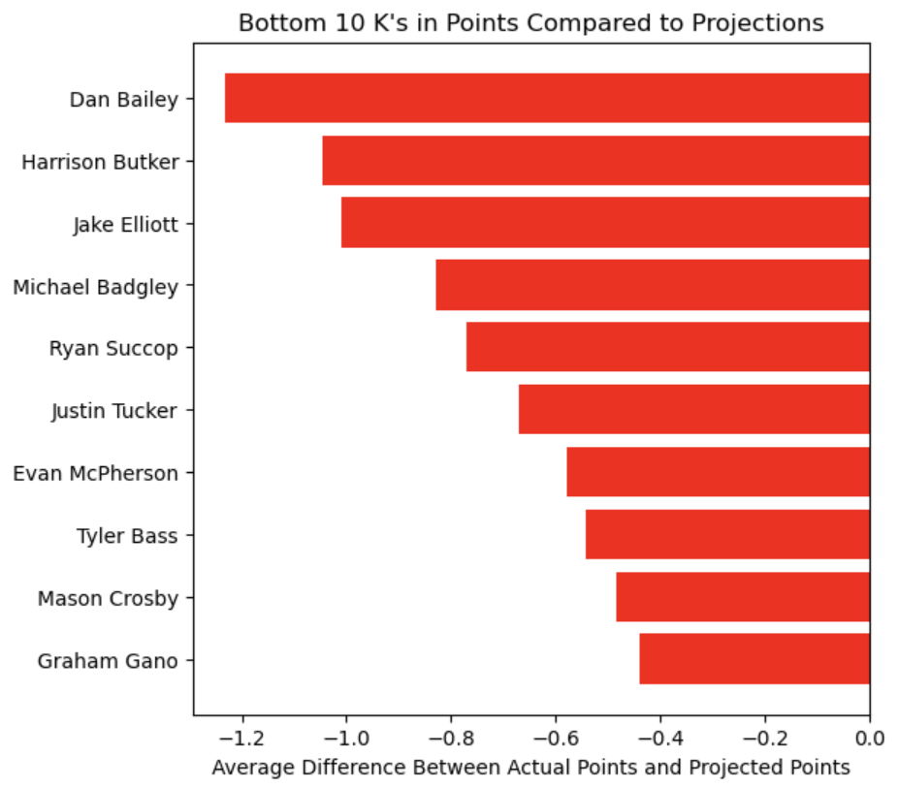
Which players outperform projections most often? K

Slide 14
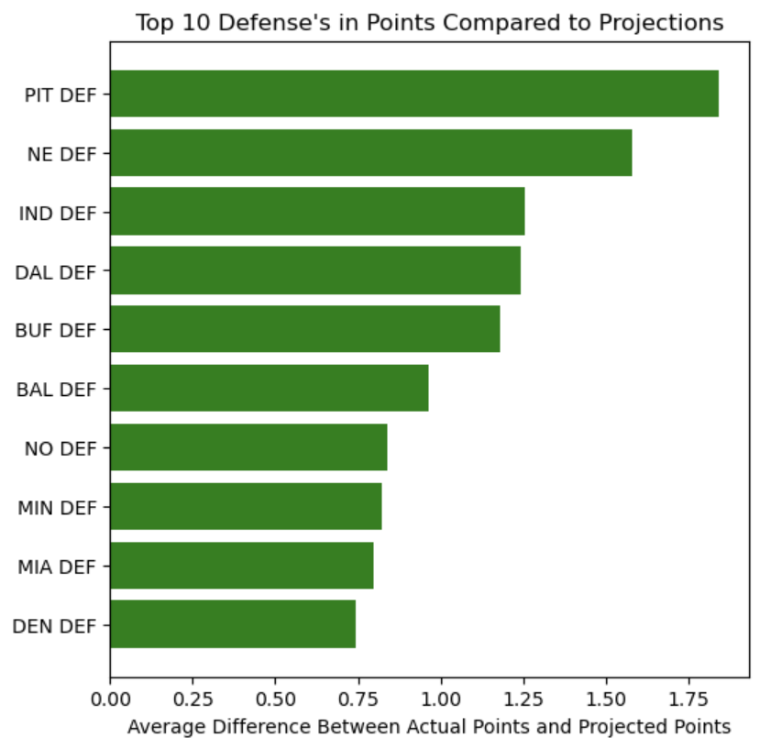
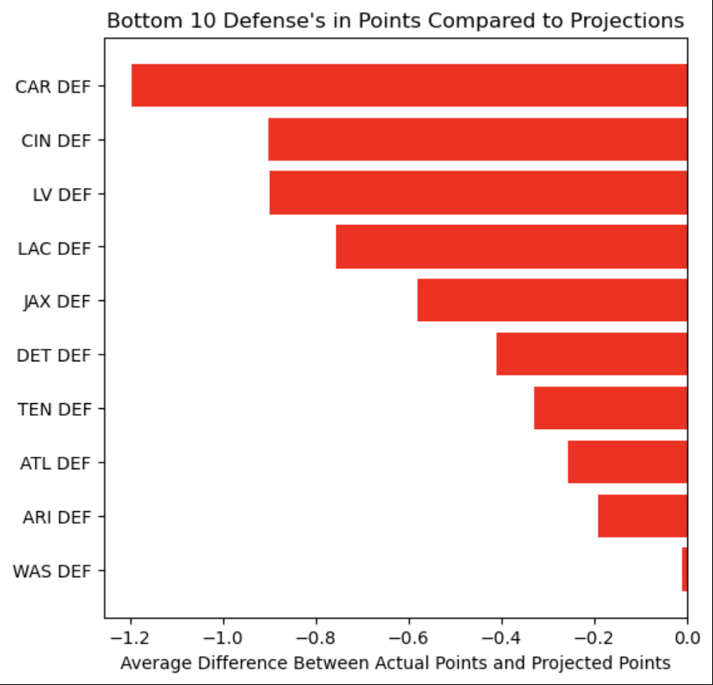
Which players outperform projections most often? DEF

Slide 15
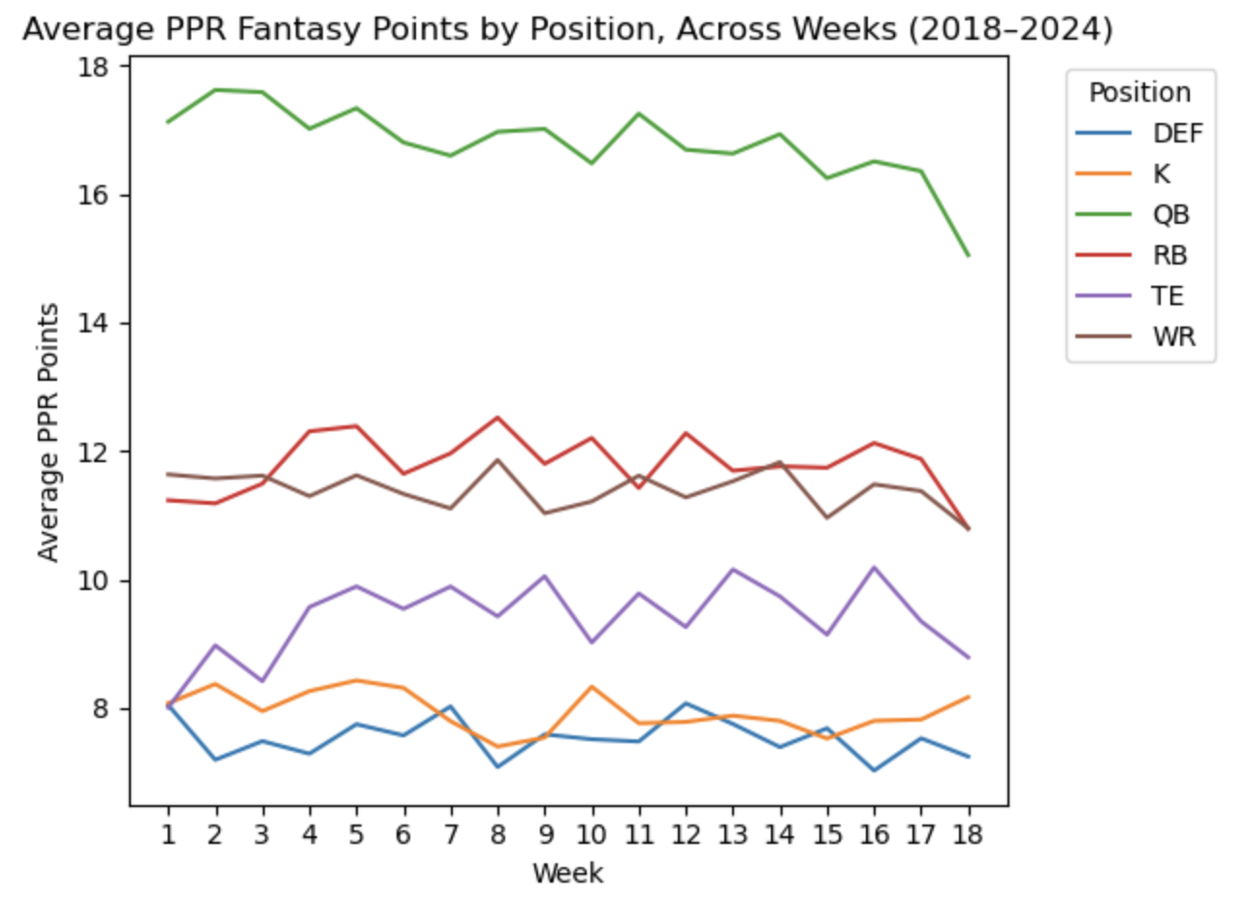
Are there Seasonal Trends in Fantasy Scoring?
QBs stay fairly stable throughout the season, slight dip towards end of the season.
Other positions like RB, WR and TE see occasional peaks and valleys throughout the season, minor dip at the end of the season
This dip could be due to injuries, usage, weather, or teams resting starters for the playoffs

Slide 16
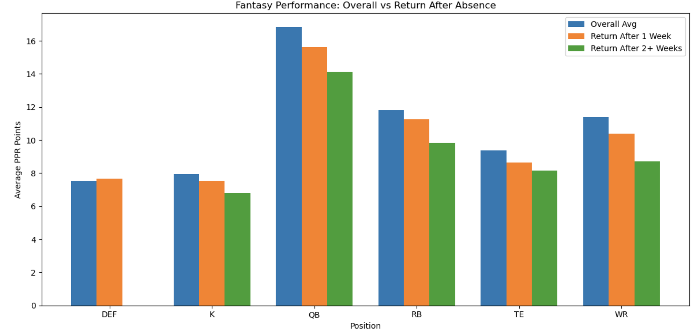
How are Players Affected off a Injury/Bye Week
We see that offensive players coming off an absence have lower fantasy numbers compared to the overall average.
Extra weeks of absence does not benefit player performance.
Defenses have slightly higher performance off a bye week. Indicating extra rest is beneficial for defensive units.

Slide 17
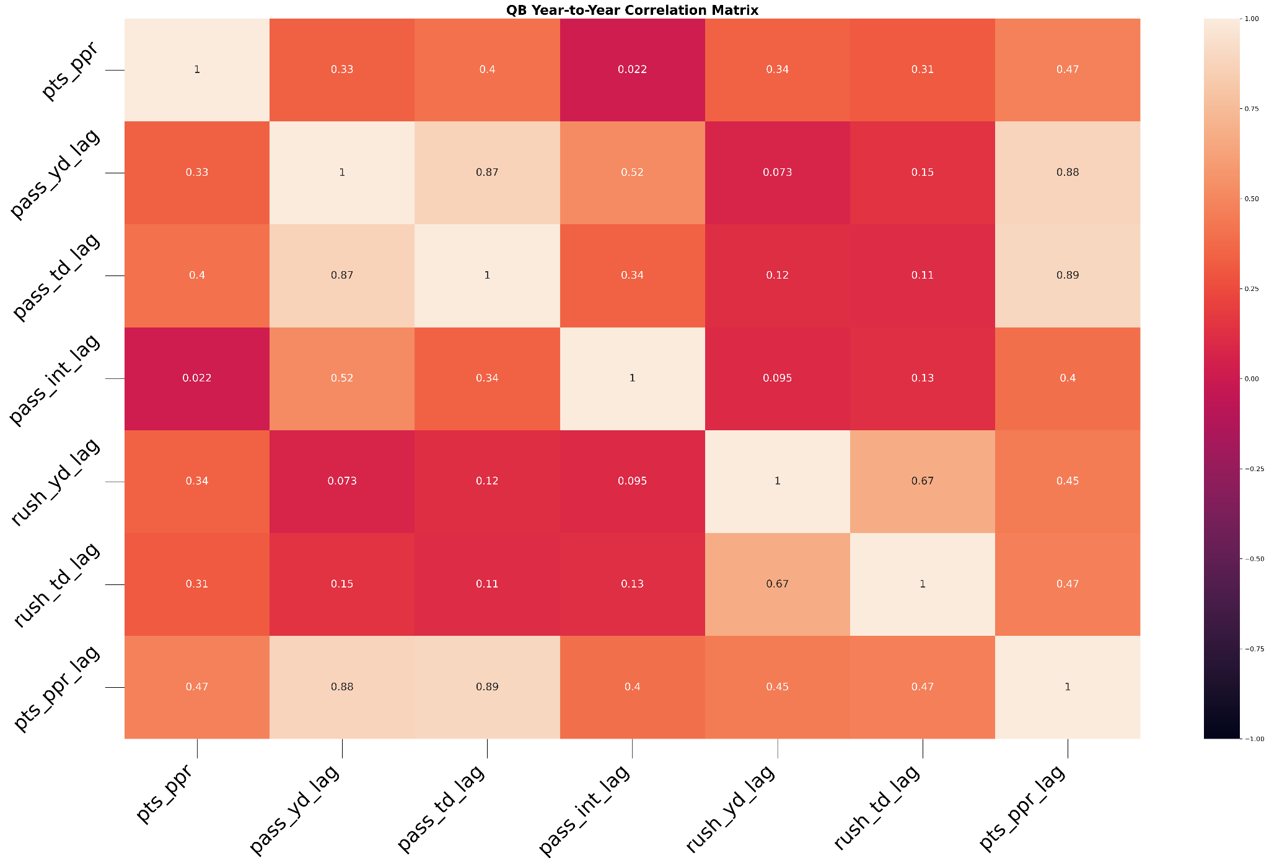
How well does previous season fantasy points project next season’s fantasy points? Are there specific stats that project this better than others?

Slide 18
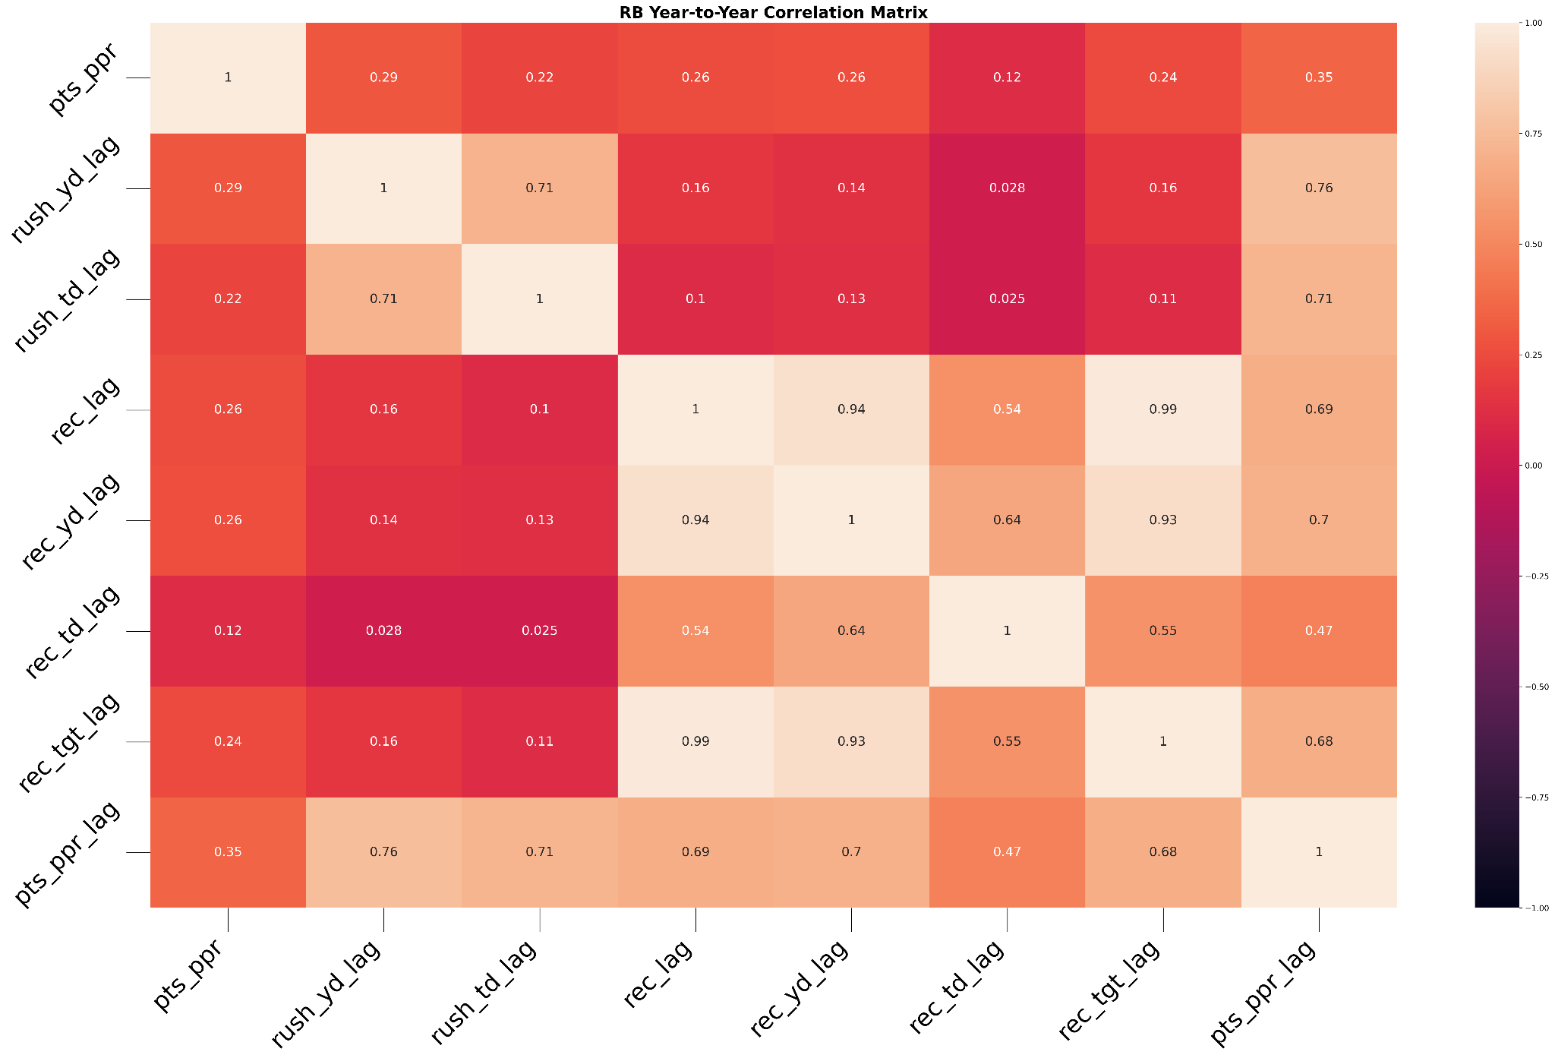
How well does previous season fantasy points project next season’s fantasy points? Are there specific stats that project this better than others?

Slide 19
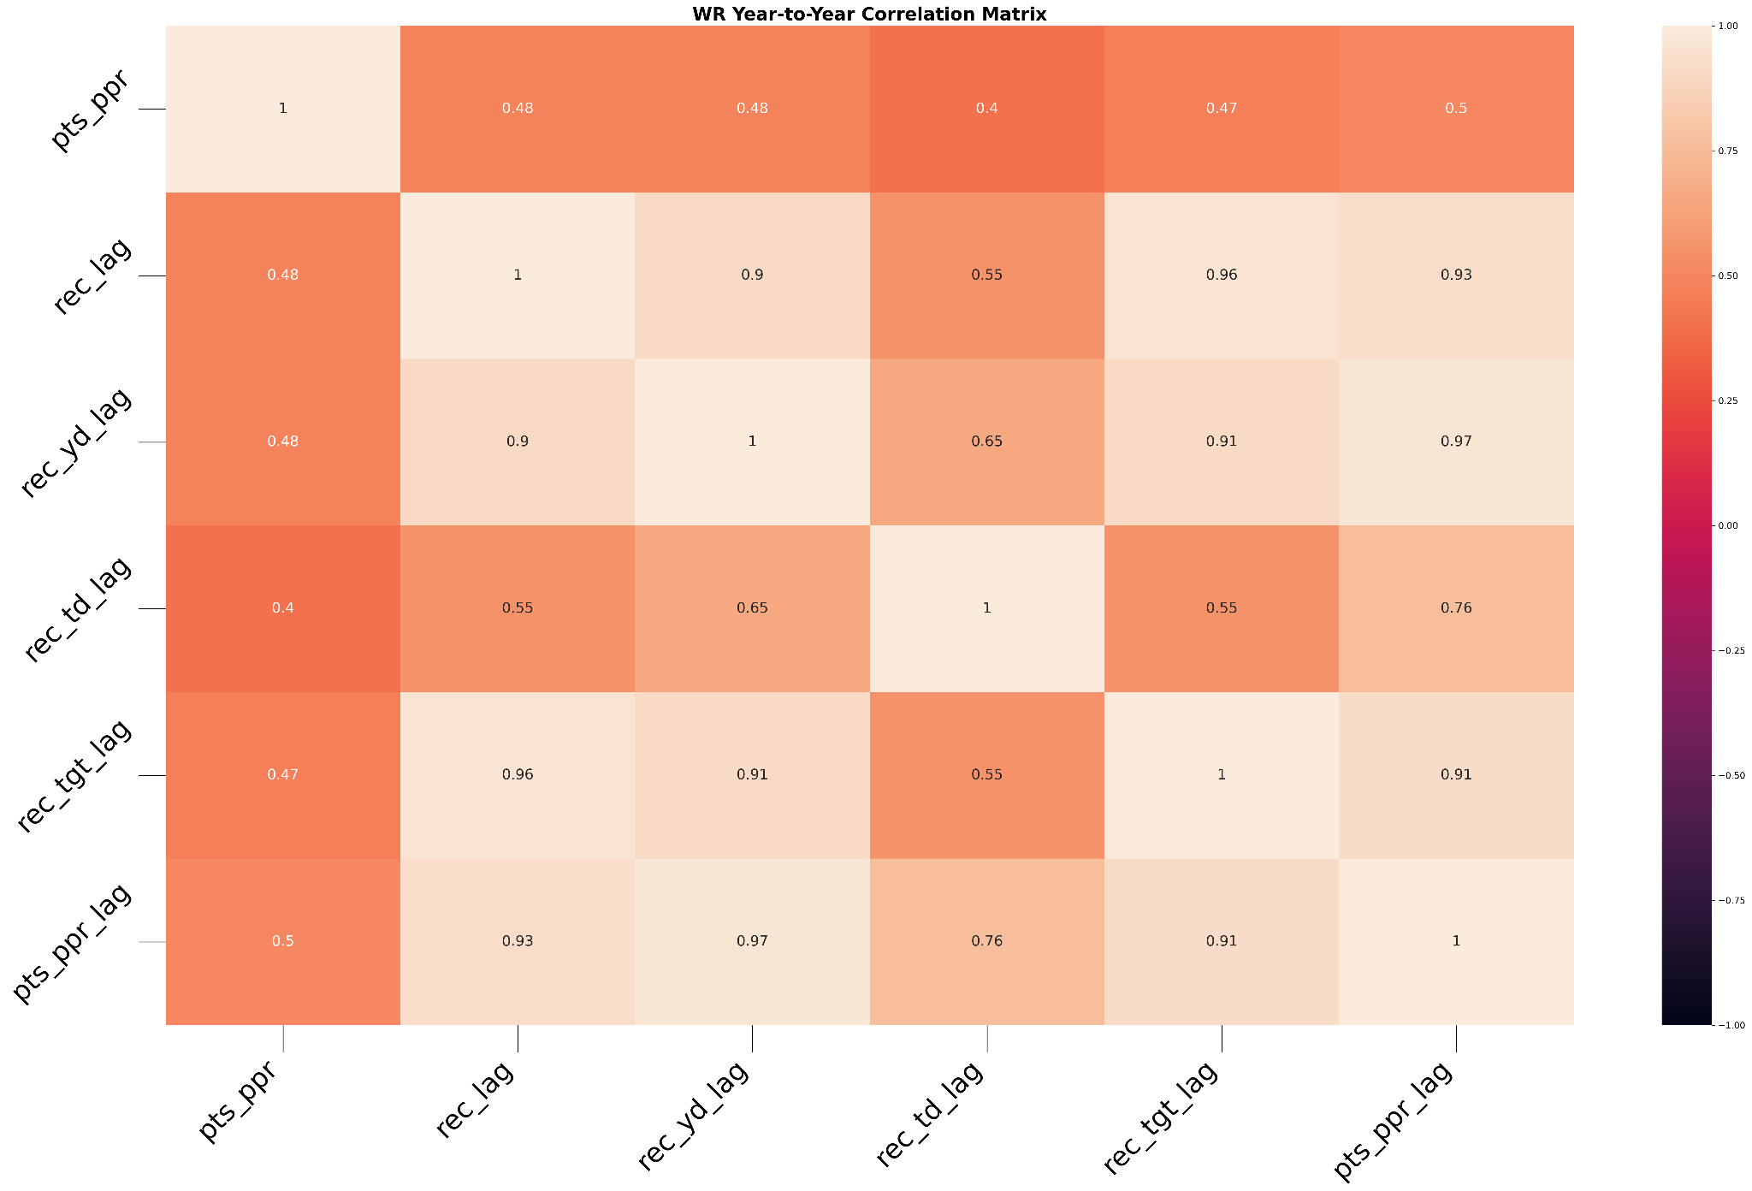
How well does previous season fantasy points project next season’s fantasy points? Are there specific stats that project this better than others?

Slide 20
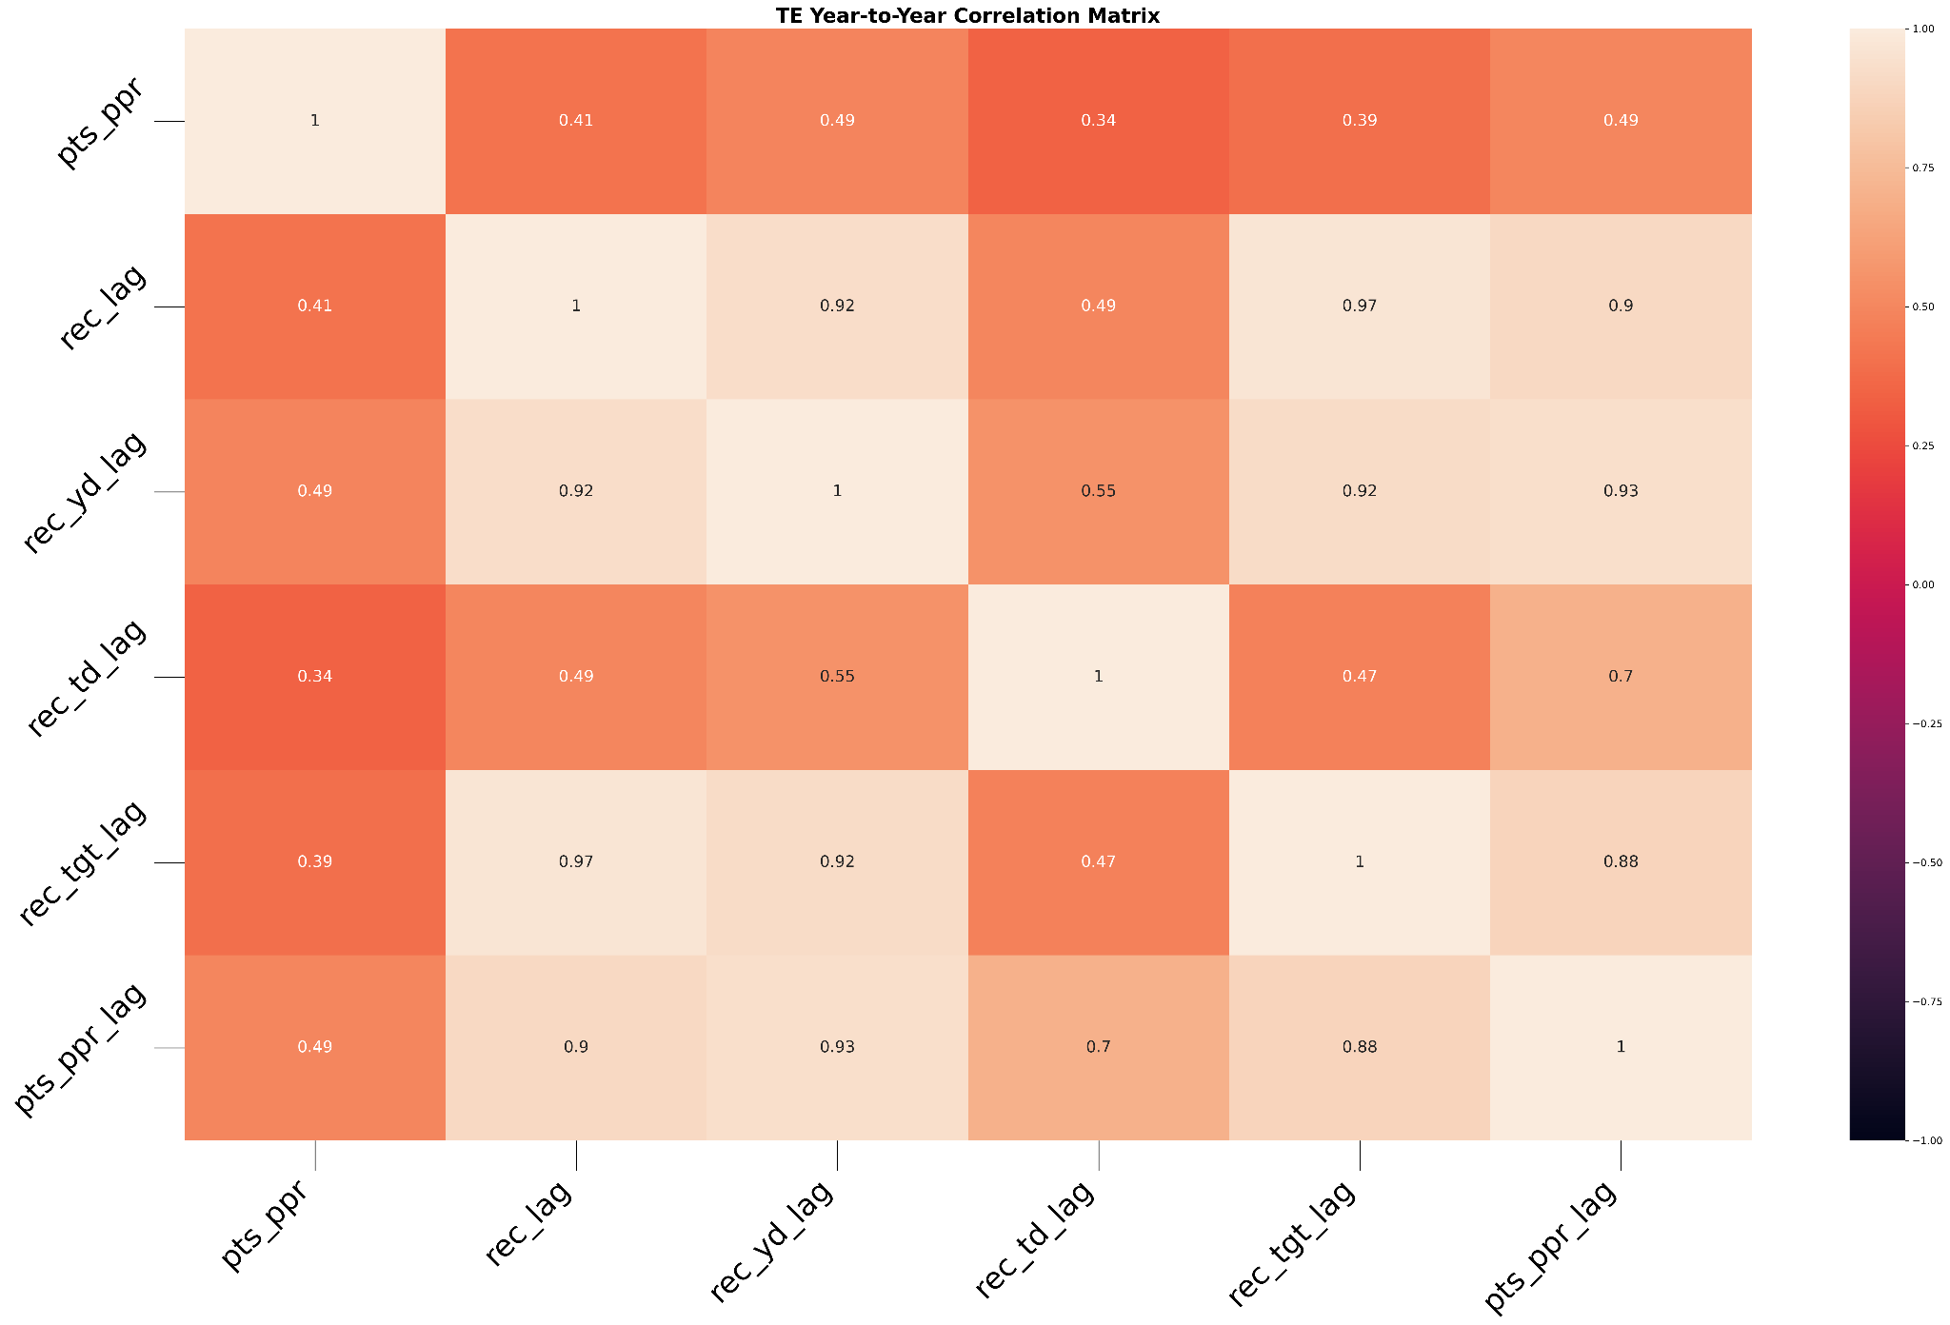
How well does previous season fantasy points project next season’s fantasy points? Are there specific stats that project this better than others?

Slide 21
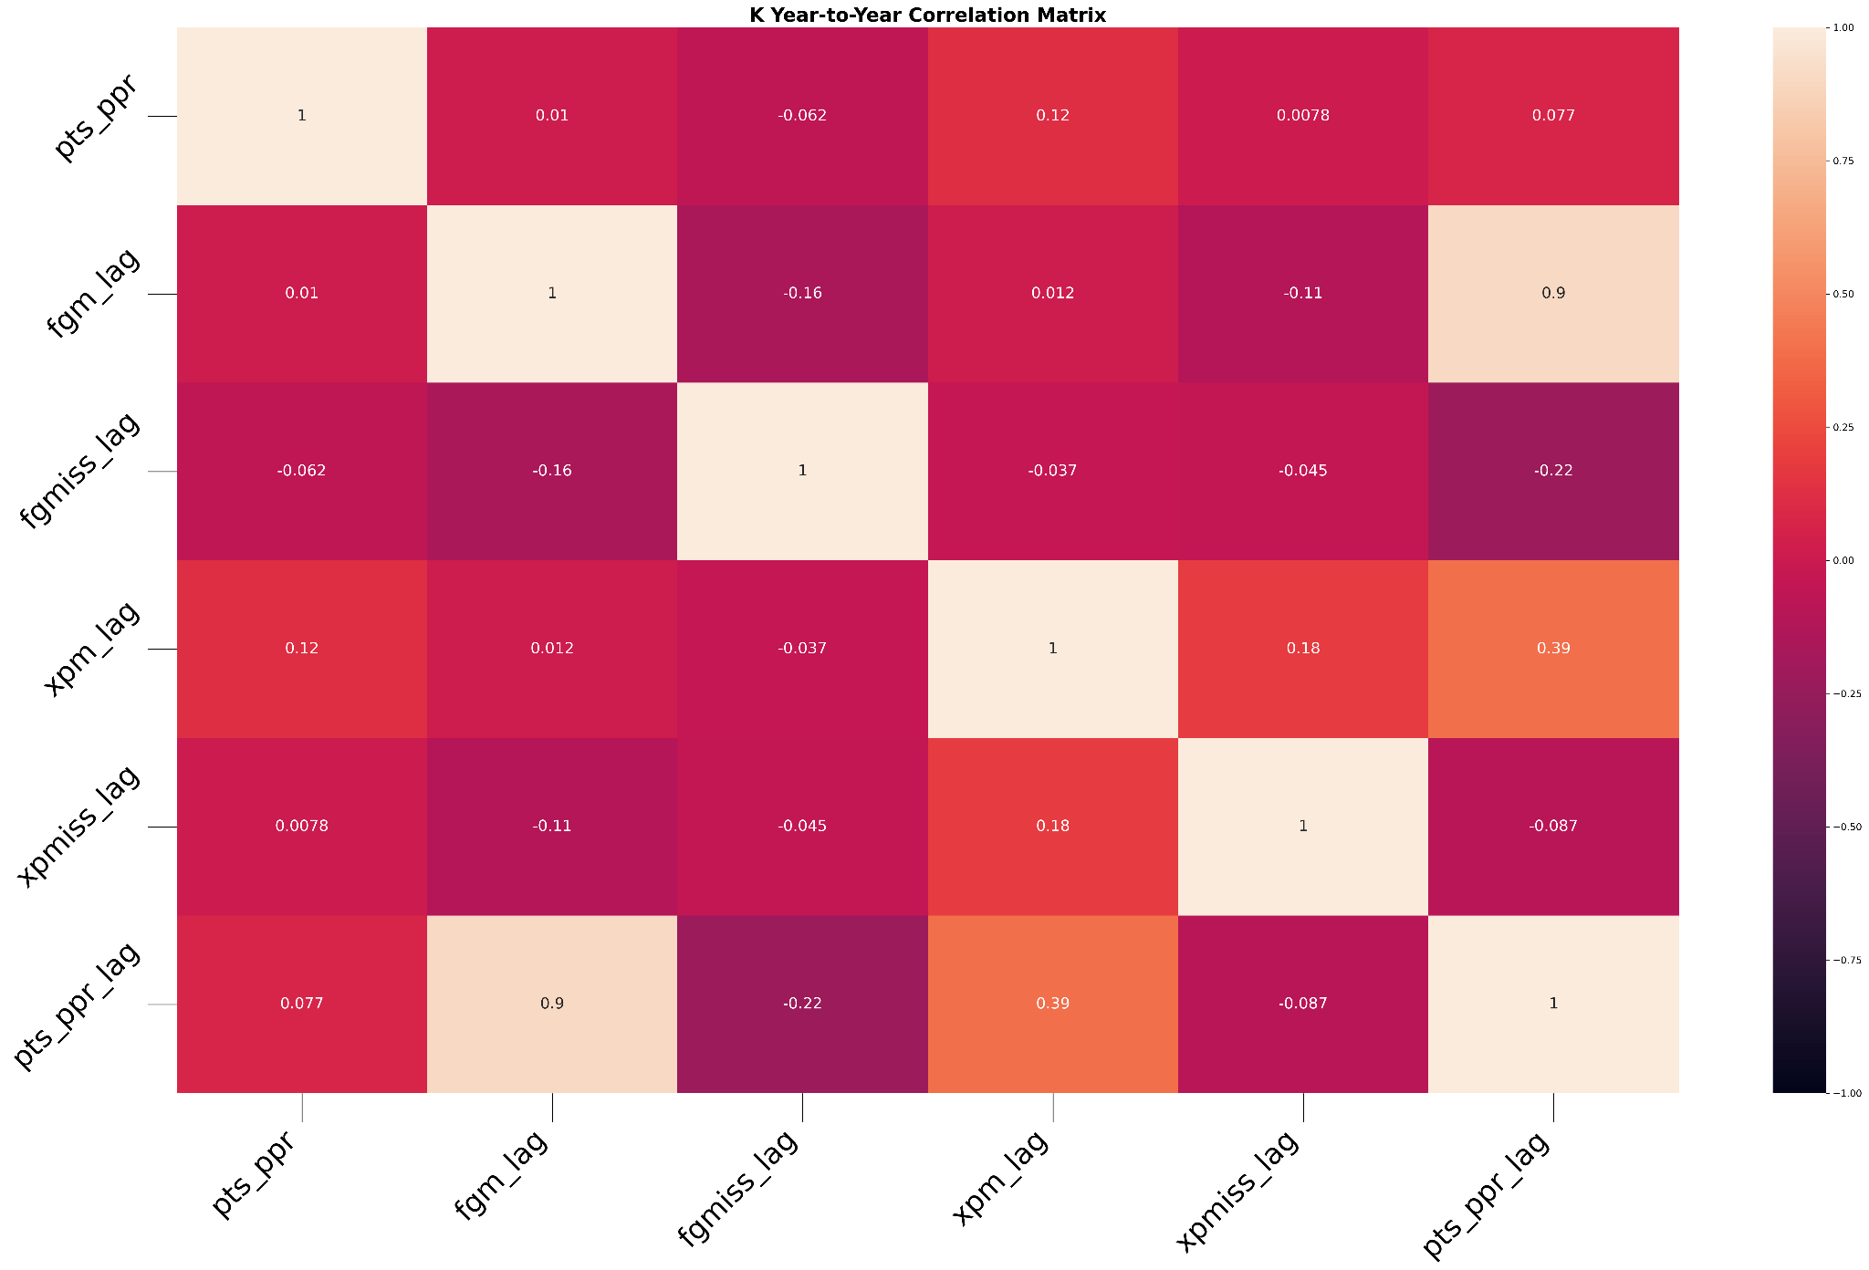
How well does previous season fantasy points project next season’s fantasy points? Are there specific stats that project this better than others?

Slide 22
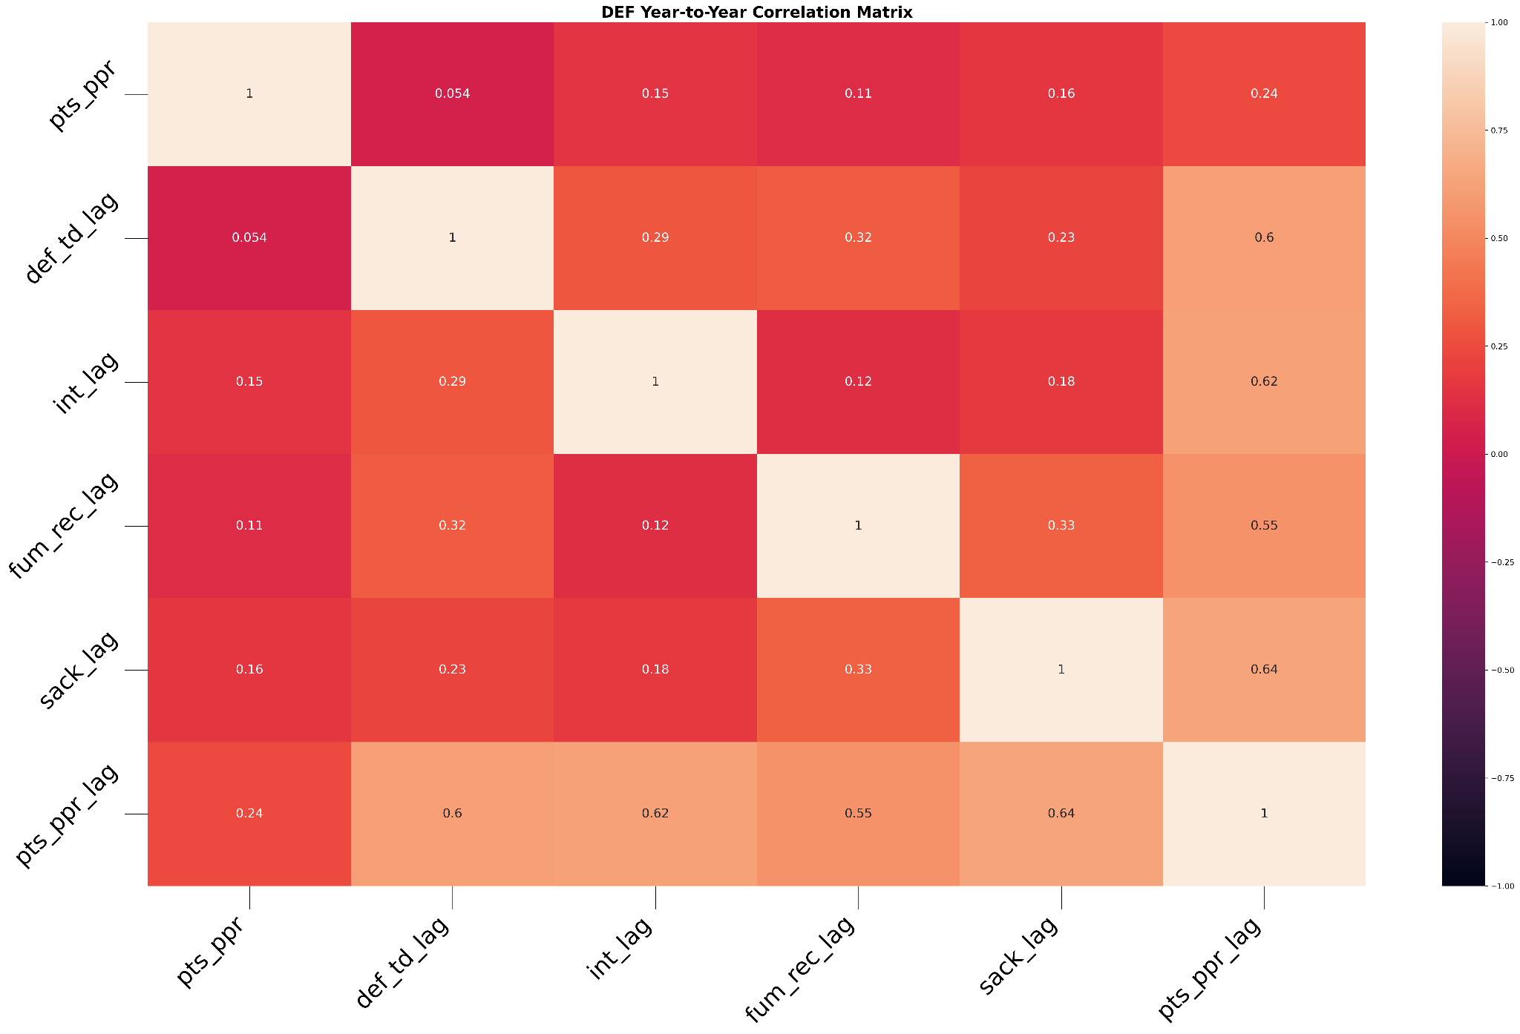
How well does previous season fantasy points project next season’s fantasy points? Are there specific stats that project this better than others?

Slide 23
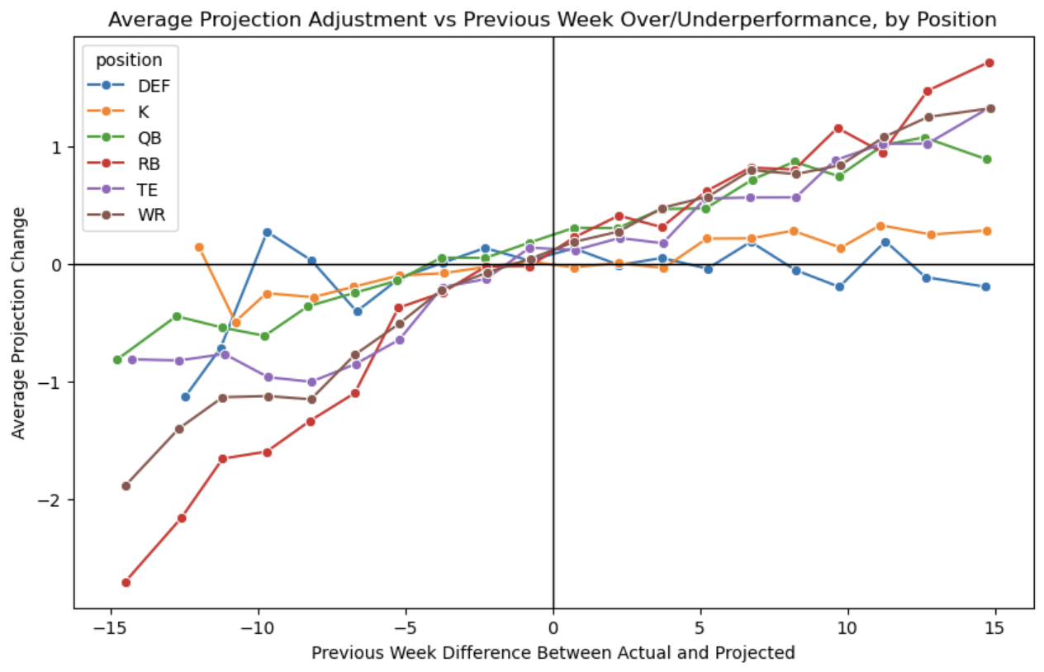
How do projections adjust to performances from the previous week?
WR and RB are the positions whose projections are adjusted the most based on week-to-week performance.
QB, RB, WR, and TE projections all increase with a good performance in the previous week.
K and DEF projection changes have no such pattern, indicating that projections for these positions are more matchup-based.

Slide 24
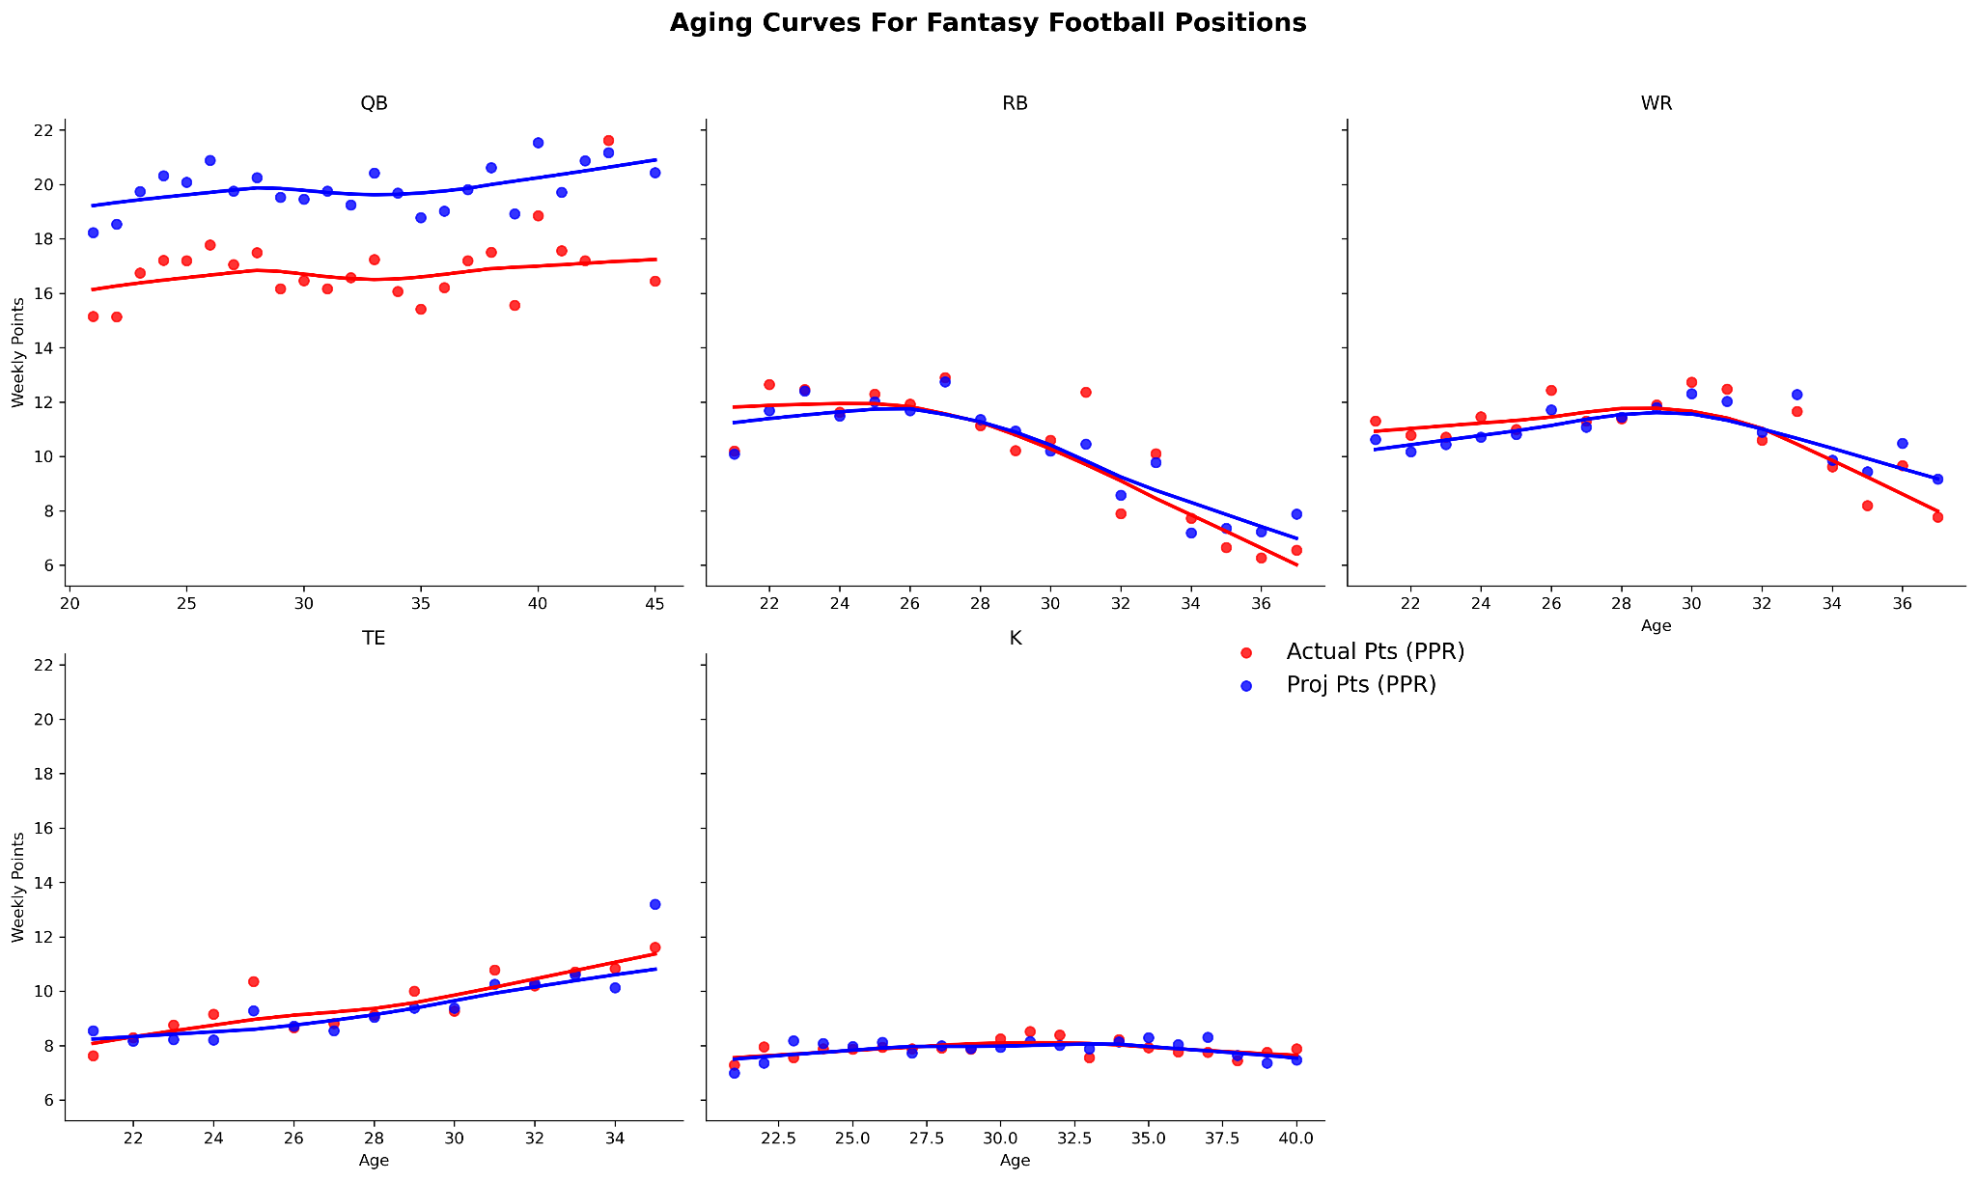
Aging curve for fantasy projections and outcomes. How does age affect performance and projections?
Projection systems seem to consistently overestimate weekly performance among QBs
RBs are the earliest to peak at around 26-28 before a steep decline in performance by their 30s
WRs Peak at 30 before performance drops off
K stay relatively consistent despite age.

Slide 25
Overall Takeaways
Projection systems seem to do a poor job at projecting QB performance, but QBs also provide the most consistent performance from week-to-week.
Fantasy performance remains consistent as the season progresses across all positions
Bye weeks & injuries seem to slightly hurt performance in every position besides defense
Across all positions, last season fantasy points does the best job of predicting future performance
Projections are more performance-based for WRs & RBs while DEF are more matchup based
RBs & WRs see performance decline by their 30s while QBs & Ks aren’t affected by age as much

